Slide 1
Employee Data Analysis using Excel
STUDENT NAME:A. NANDHINI
REGISTER NO: 2213331042123
DEPARTMENT: COMMERCE
COLLEGE: BHRATARATHI WOMEN'S COLLEGE

Slide 2
PROJECT TITLE
Employee Attendance Analysis using Excel

Slide 3


AGENDA
Problem Statement
Project Overview
End Users
Our Solution and Proposition
Dataset Description
Modelling Approach
Results and Discussion
Conclusion
3/21/2024 Annual Review

Slide 4

PROBLEM STATEMENT
The company is facing significant challenges with employee attendance, including high absenteeism and frequent tardiness. These attendance issues are affecting overall productivity, team dynamics, and project timelines. The goal is to analyze employee attendance data to identify patterns and trends, assess the impact of these patterns on organizational performance, and develop actionable strategies to improve attendance and reduce disruptions.

Slide 5

PROJECT OVERVIEW
.
The primary aim of this project is to analyze employee attendance data to identify trends, uncover issues, and provide actionable insights that can enhance workforce management and productivity

Slide 6

WHO ARE THE END USERS?
End users are the individuals or groups who ultimately use or are affected by a product, service, or system. They are the final recipients of the product's benefits and typically interact with it directly.

Slide 7

OUR SOLUTION AND ITS VALUE PROPOSITION
End users are the individuals or groups who ultimately use or are affected by a product, service, or system. They are the final recipients of the product's benefits and typically interact with it directly.

Slide 8
Dataset Description
dataset description provides a summary of the dataset's contents, structure, and purpose. Key elements typically included are:Title: The name of the dataset.Description: A brief overview of what the dataset is about, including its context and relevance.Source: Where the data was obtained from, such as a database, survey, or web scraping.Data Fields/Attributes: A list of columns or variables in the dataset, including their names, types (e.g., integer, string, date), and a brief description of each.

Slide 9

THE "WOW" IN OUR SOLUTION
The "WOW" in our solution lies in its innovative technology that delivers unparalleled efficiency and exceptional user experience. It integrates seamlessly with existing systems, offers high scalability, and provides customizable features that meet diverse needs. This combination of cutting-edge design and practical benefits ensures outstanding performance and impactful results.
3/21/2024 Annual Review
9

Slide 10
MODELLING
Employee attendance analysis modelling involves collecting and cleaning attendance data, then using statistical and machine learning techniques to uncover patterns and predict future trends. Key steps include performing exploratory data analysis to understand basic trends, engineering features such as historical attendance and employee demographics, and applying models like time series forecasting or classification to predict absenteeism and detect anomalies.
10

Slide 11
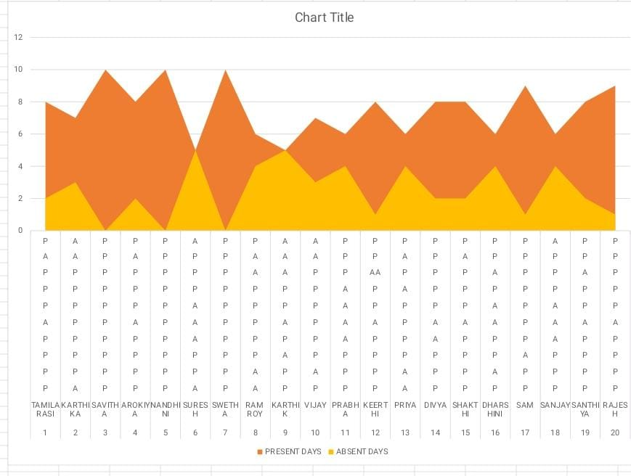
RESULTS
11

Slide 12
conclusion
In conclusion, employee attendance analysis provides valuable insights into workforce patterns and absenteeism trends. By systematically collecting and analyzing attendance data, organisations can identify underlying issues, predict future attendance trends, and make informed decisions to improve overall productivity and employee satisfaction. Implementing robust models and continuously monitoring their performance helps in adapting to changing dynamics and optimising attendance management strategies. This proactive approach not only enhances operational efficiency but also supports better workforce planning and resource allocation.

